Slide 1
Python for Network Programming, Part 1
CPSC 3600

Slide 2
Learning Objectives for Today
Write and run basic python programs
Catch exceptions thrown by your programs
Debug python programs using an IDE

Slide 3
Survey
Help me get a sense of the class’ experience with key topics
https://clemson.ca1.qualtrics.com/jfe/form/SV_0w8HVnbNknndd0W
Download Python 3.8.10 here

Slide 4
Why Python?
Python is portable
Python is simple
Python provides straightforward access to the low-level socket API
What you learn about networking in Python will easily transfer to almost all other languages
Knowledge of Python is beneficial for future employment

Slide 5
Helpful Python Resources
Interactive resources
https://www.codecademy.com/learn/learn-python-3
http://introtopython.org/
https://www.learnpython.org/
Articles
https://realpython.com/python-introduction/

Slide 6
Python 2 vs. Python 3
Two major versions of Python are still commonly used: v2 and v3
There are breaking changes between Python2 and Python3
We will use Python3 for this course
When learning about Python, make sure any resources you reference is written for Python3
Python2 resources can still be useful, but will likely contain errors that you will have to fix before the code with run in Python3
If Python2 and Python3 are both installed on a computer, you have to specify which version you want to use when running a program
Example on next slide

Slide 7
Running Python Programs
Python is an interpreted language: no compilation required
Python scripts are executed directly via the command line
This assumes your PATH variable includes the Python install directory
If Python2 and Python3 are both installed, instead try the following
Both Python2 and Python3 are installed on some CPSC lab machines. Forgetting this is a common cause of errors.
C:\> python my_script.py
C:\> python3 my_script.py

Slide 8
Running Python Programs
Running the python command without specifying a script will open an interactive Python session
Tip: Use this to check what version is linked to the python command
Once in the interactive session, you can begin coding immediately
This is helpful for learning Python, but isn’t a recommended way to actually develop your programs. Use an IDE for that
C:\> python
Python 3.7.1 (default, Dec 10 2018 22:54:23) [MSC v.1915 64 bit (AMD64)]
Type “help”, “copyright”, “credits” or “license” for more information.
>>>

Slide 9
Running Python Programs
C:\> python
Python 3.7.1 (default, Dec 10 2018 22:54:23) [MSC v.1915 64 bit (AMD64)]
Type “help”, “copyright”, “credits” or “license” for more information.
>>> i=3
>>> j=77
>>> i*j
231
>>> result = i*j
>>> print(result)
231
>>>

Slide 10
Variables
Variables do not need to be declared in advance. Just assign it a value
Variables are not statically typed
You can assign a value of any data type to any variable
This can be a common cause of errors!
Be careful you don’t create a “new” variable that is the same name as an old one, as you’ll just overwrite the old one.
packet_data = 388
packet_data = “This is a string”
packet_data = 388
packet_data = “This is a string”
C: ERROR! Can’t assign an int and a string to the same var
Python: OK to assign a string to a var that contains an int

Slide 11
Important Data Types in Python
Integers
Floats
Strings
Booleans
Lists and Arrays
Dictionaries

Slide 12
Strings
Can use either ‘’ or “” to define a string
Strings can be concatenated as string1 + string2
Non-strings must be converted to strings before concatenation using the str() function
Forgetting this conversion is a common cause of errors
msg_num = 1
print(“Received message “ + msg_num)
msg_num = 1
print(“Received message “ + str(msg_num))
ERROR! msg_num not converted to a string
Successful Concatenation

Slide 13
Lists and Arrays
Lists and arrays are similar data types, with a few differences
Both store data, are mutable, and can be iterated through
Lists are a built-in data type, arrays have to be imported
Lists can store objects of different types, arrays can’t
Arrays are optimized for arithmetic operations, lists don’t support them
Unless performing arithmetic operations, use lists instead of arrays
a_list = []
a_list.append(1)
a_list.append(2)
a_list.append(“the end”)
len(a_list) # returns 3
a = [‘foo’, ‘bar’, ‘lorem’, ‘ipsum’]
print(a[2])
>>> lorem
‘foo’ in a # returns True
‘tigers’ not in a # returns True

Slide 14
Lists and Arrays
Lists can contain other lists
Useful Methods
x.append(<obj>) → adds <obj> to the end of the x
x.insert(<index>, <obj>) → insert <obj> at <index> in x
x.remove(<obj>) → removes a specific object
x.pop() → removes and returns the last item from the list
x = [‘foo’, [1,2,4], ‘lorem’, [‘a’, [‘b’]]
x[0] # returns ‘foo’
x[1] # returns [1,2,4]
x[1][2] # returns 4
x[3][1] # returns [‘b’]
x[3][1][0] # returns ‘b’

Slide 15
Dictionaries
Dictionaries store key-value pairs
Sometimes called HashTables or HashMaps in other languages
Key must be unique, value can be anything
A dictionary can store keys (and values) of different data types
# Create a dictionary
x = {
‘Red’: ‘Fish’,
‘Blue’: ‘Fish’,
‘Green’: ‘Eggs’,
37: 42
}
# Add to dictionary
x[‘Clemson’] = ‘Tigers’
# Access a value in dictionary
x[‘Red’] # Returns ‘Fish’
x[‘Green’] # Returns ‘Eggs’
x[37] # Returns 42
# Modify dictionary
x[‘Blue’] = ‘Tiger’
x[‘Blue’] # Returns ‘Tiger’
del x[‘Green’] # Removes ‘Green’ key-value pair
x[‘Green’] # Raises KeyError exception

Slide 16
Dictionaries
# Create a dictionary
x = {
‘Red’: ‘Fish’,
‘Blue’: ‘Fish’,
‘Green’: ‘Eggs’,
37: 42
}
# Determine if a key exists in dict
‘Red’ in x # Returns True
‘Yellow’ in x # Returns False
‘Yellow’ not in x # Returns True
# Find number of key-value pairs
len(x) # Returns 4
# Accessing values in a dictionary
x[‘Red’] # Returns ‘Fish’
x.get(‘Red’) # Returns ‘Fish’
x[‘Yellow’] # Raises a KeyError exception
x.get(‘Yellow’) # Returns None (i.e. null)
x.pop(‘Red’) # Returns ‘Fish’, removed from dict
# Raises KeyError if not present
# Accessing multiple values in dictionary
x.items() # Returns list of key-value pairs
x.keys() # Returns list of keys
x.values() # Returns list of values
# Resetting the dictionary
x.clear() # Removes contents of dict

Slide 17
Operations
Standard arithmetic operations
/ is always float division
// used for integer division
** used for exponentiation
Standard comparison operations
Logical operators
True, False
not, or, and
Identity operators
== compares value, is checks if they reference the same object

Slide 18
Whitespace in Python
Whitespace serves a special function in Python
C-type languages define blocks of code using { }
Python defines blocks of code using indentation at the start of the line
Each block nested inside of another block must be indented once more than its parent
Be consistent in how you indent! Mixing spaces and tabs will break
x = True; y = False;
if (x == True) {
if (y == True) {
printf(“Done”);
}
}
x = True; y = False
if x == True:
if y == True:
print(“Done”)
C
Python

Slide 19
Whitespace in Python
Whitespace serves a special function in Python
C-type languages define blocks of code using { }
Python defines blocks of code using indentation at the start of the line
Each block nested inside of another block must be indented once more than its parent
x = True; y = False;
if (x == True) {
if (y == True) {
printf(“Done”);
}
}
x = True; y = False
if x == True:
if y == True:
print(“Done”)
Hard to read, but valid C. Will not print Done
Invalid Python! Will print “Done” (if it ran)

Slide 20
Pass
Any statement that creates a new block MUST contain something
if, for, while, functions, …
Sometimes you want to stub out a loop, or a function, but aren’t ready to create content yet
If so, put the pass statement in the block
x = True; y = False
if x == True:
if y == True:
print(“Done”)
x = True; y = False
if x == True:
pass
if y == True:
pass
print(“Done”)
No content in the two if blocks, will raise an error
pass included in both if blocks, will run successfully

Slide 21
Conditionals
if x > 3:
print(x)
elif y > 3:
print(y)
elif z > 3:
print(z)
else:
print(‘None’)

Slide 22
Loops
For loops in Python function like foreach loops in C++ or Java
Rather than iteratively changing an index value, you iteratively examine new elements of a list
tigers = [‘siberian’, ‘sumatran’,
‘clemson’]
for (i; i < sizeof(tigers); i++) {
print(tigers[i])
}
>>> ‘siberian’
‘sumatran’
‘clemson’
tigers = [‘siberian’, ‘sumatran’,
‘clemson’]
for t in tigers:
print(t)
>>> ‘siberian’
‘sumatran’
‘clemson’
C pseudocode
Python

Slide 23
Loops
If you need to loop through a list of numbers, use range to create it
Range creates a list of all numbers within a given range
You can specify starting value, end value, and increment value
# Prints 0,1,2,3,4,5,6
for j in range(7):
print(j)
# While loop equivalent
i = 0
while i < 7:
i = i+1
print(i)
# Prints 3,4,5,6,7,8,9
for j in range(3,10):
print(j)
# Prints 3,6,9
for j in range(3,10,3):
print(j)

Slide 24
Loops
If you need both the index and value of each element in a list, you can do that using the enumerate function
tigers = [‘siberian’, ‘sumatran’, ‘clemson’]
for idx, val in enumerate(tigers):
print(idx + “:” + val)
>>> ‘0:siberian’
‘1:sumatran’
‘2:clemson’

Slide 25
Functions
Functions are specified using the def keyword
# Basic function
def multiply(a,b):
return a*b
x = multiple(3,4)
print(x)
>>> 12
# No return statement
def print_twice(s)
print(s)
print(s)
# Named parameters with
# default values
def raise_to(x,y=2):
return x**y
a = raise_to(3,3)
print(a)
>>> 27
b = raise_to(y=3,x=2)
print(b)
>>> 8
c = raise_to(2)
print(c)
>>> 4
# Multiple return values
def fractional_division(a,b):
quotient = a // b
remainder = a % b
return quotient, remainder
q, r = fractional_division(15,7)
print(q)
>>> 2
print(r)
>>> 1

Slide 26
Main Method
Python script files can be run immediately in the console. They do not necessarily require a “main method”
However, often using this structure is helpful, especially with OOP
Python defines main methods using the following syntax
When you run a Python script, it will look to see if a main method is present. If so, it will begin execution there. Otherwise it will run the file from top to bottom
if __name__ == "__main__":
pass

Slide 27
Object-Oriented Programming
Classes are defined as follows
Code defined in a class can reference the current instance of the class using the self keyword. This is similar to this from C++ and Java
class FootballPlayer:
pass

Slide 28
Object-Oriented Programming
Functions can be defined in a class as follows
The self argument must be the first argument in all class functions
You do NOT pass a value for self in when calling the function, Python handles this automatically. These are common causes of errors.
class FootballPlayer:
def throw(self, item):
print(“Throwing the ball!”)
def play(self, ball):
# You DON’T pass a value for self into the function
# You MUST write self.throw(...), not throw(...), as throw is a member
# function of this class
self.throw(ball)

Slide 29
Object-Oriented Programming
To define an instance-level variable within a function, preface it with self
If you don’t call self, the variable will be defined at the function-level
If you try and call an instance-level variable without self, it won’t work
You will get an error, or mistakenly create a new function-level variable
class FootballPlayer:
def hydrate(self):
self.hydration = 100
def sweat(self, amount):
self.hydration = self.hydration - amount

Slide 30
Object-Oriented Programming
Create a constructor using the __init__ function
class FootballPlayer:
def __init__(self, name, number)
self.name = name
self.number = number
self.hydration = 100
def sweat(self, amount):
self.hydration = self.hydration - amount
qb= FootballPlayer(
name = “Trevor Lawrence”,
number = 16)
wr= FootballPlayer(
name = “Justyn Ross”,
number = 8)
qb.sweat(20)
wr.sweat(45)
print(qb.hydration)
>>> 80
print(wr.hydration)
>>> 55
qb.name = “Deshaun Watson”
print(qb.name)
>>> “Deshaun Watson”

Slide 31
Exceptions
Exceptions are raised by programs when something goes wrong
E.g. dividing by 0 will raise the ZeroDivisionError
You WILL encounter exceptions as you code.
Sometimes this is a sign something is wrong
Sometimes you just want to execute different code after the exception
If not caught, a raised exception will terminate your program

Slide 32
Exceptions
It’s much better to catch an exception than for your program to crash
Catch exceptions using try… except… blocks
try:
x = 9/0
# This will catch a divide by 0 exception
except ZeroDivisionError as err:
print(err)
# This will catch ANY exception other than a ZeroDivsionError
except:
print (“An error happened!”)

Slide 33
Exceptions
You can raise your own exceptions using the raise command
try:
raise KeyboardInterrupt:
except:
print(“There was a keyboard interrupt!”)

Slide 34
Modules
Python automatically packages code into modules
All code in a single file is automatically a module
Sets of files can also be packaged into a module
Code in a different module must import other modules to use them
# Import numpy
import numpy
# Call the arrange function defined by numpy
a = numpy.arange(15)
# Import the arange function from numpy
from numpy import arange
# Call the arrange function defined by numpy
a = arange(15)
# Import numpy, but use a shorthand name
import numpy as np
# Call the arrange function defined by numpy
a = np.arange(15)
# Import everything numpy
from numpy import *
# Call the arrange function defined by numpy
a = arange(15)

Slide 35
Debugging Code using a Visual Debugger
One feature of IDEs is a visual debugger. This allows you to debug your code in the IDE, stepping through it and inspecting values
This is an INVALUABLE tool, and it is worth learning to use

Slide 36
Debugging Code using a Visual Debugger
The major features of a debugger are
“Breaking” (i.e. pausing) when a specific line of code is executed
Stepping through each line of code manually after a breakpoint
Inspecting the value of variables at the current moment of execution
This lets you easily:
See what code is executed in what order (check your program flow)
View the value of variables
Determine why code isn’t performing how you expect
Inspect code prior to where an exception is thrown

Slide 37
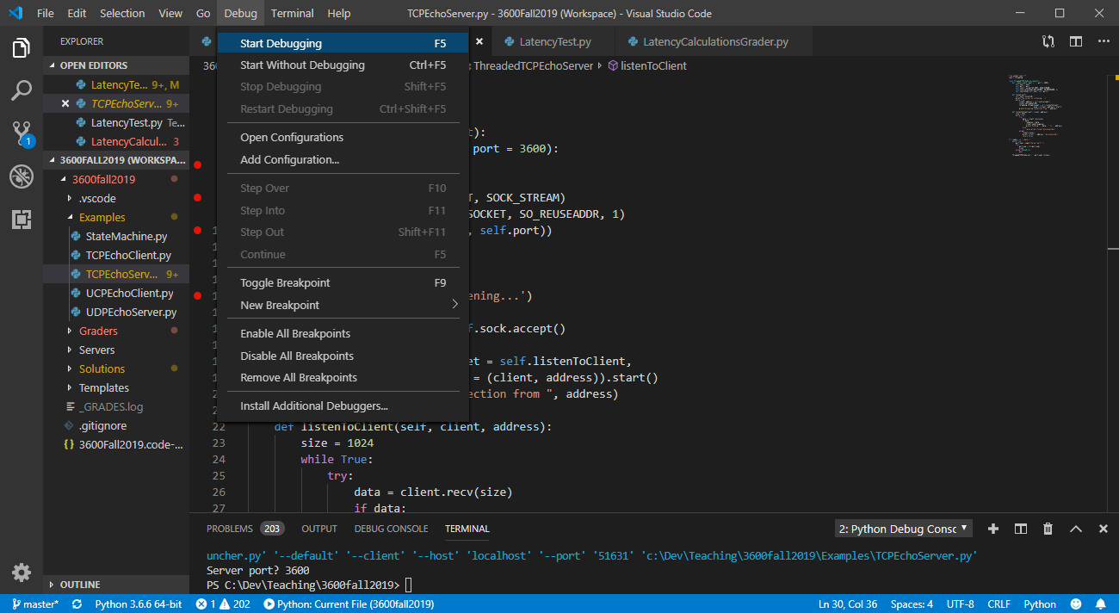

Slide 38
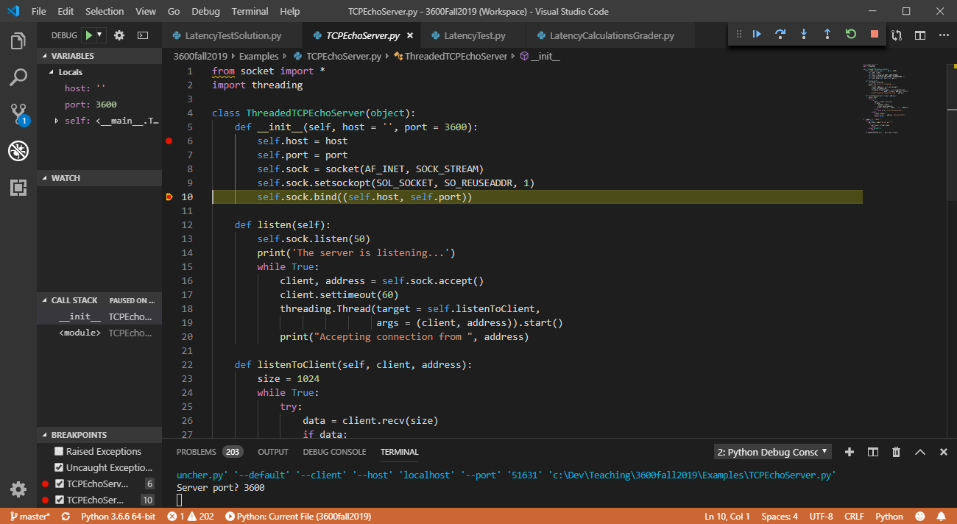

Slide 39
Breakpoint. Code stops when it reaches this line and activates the debugger.
Add a breakpoint by clicking in this column at the appropriate line.

Slide 40
This line is about to be executed. The code is paused here.

Slide 41
These tools allow us to step through the code line by line
Continue: resume normal execution
Step Over: step to the next line, not entering any functions
Step Into: step to the next line, entering into any functions
Step Out: complete the function you’re in and move to the line of code after it was called
Restart: restart the execution of the program
Stop: stop execution of the program

Slide 42
You can see details about the currently defined variables in the program here

Slide 43
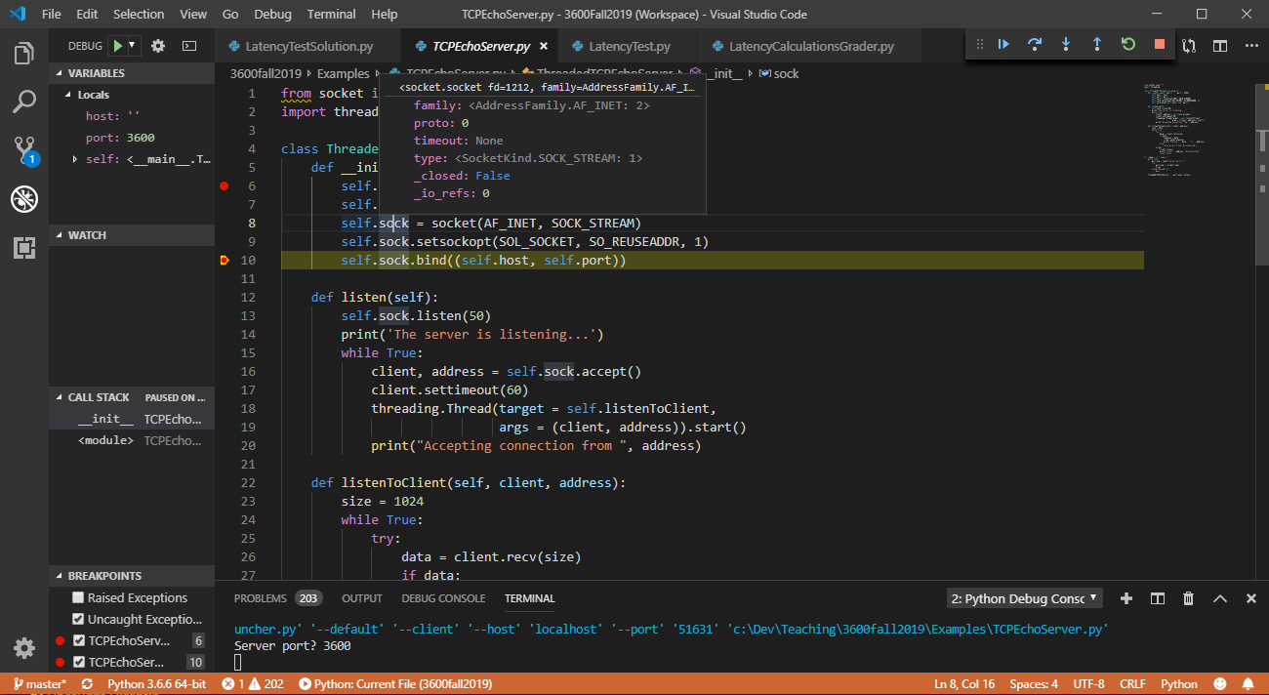
Inspecting the contents of self.sock. You can inspect the current value of any variable by hovering your mouse over it

